Slide 1
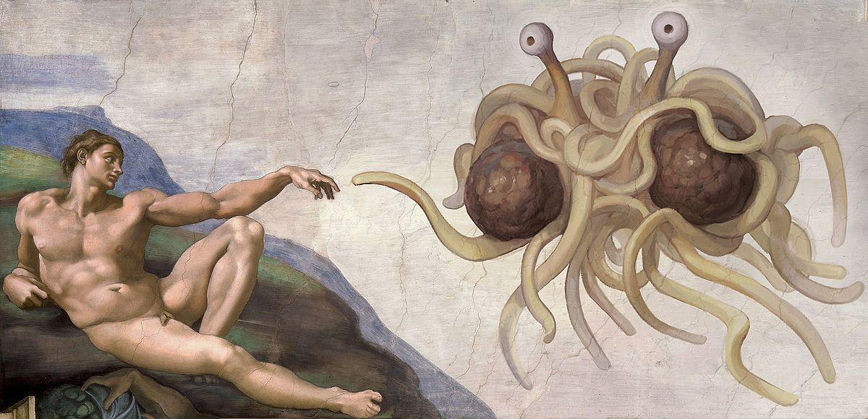
Lecture 3: Bivariate statistics

Slide 2
Today
Introduction to bivariate data
Regression
Correlation

Slide 3
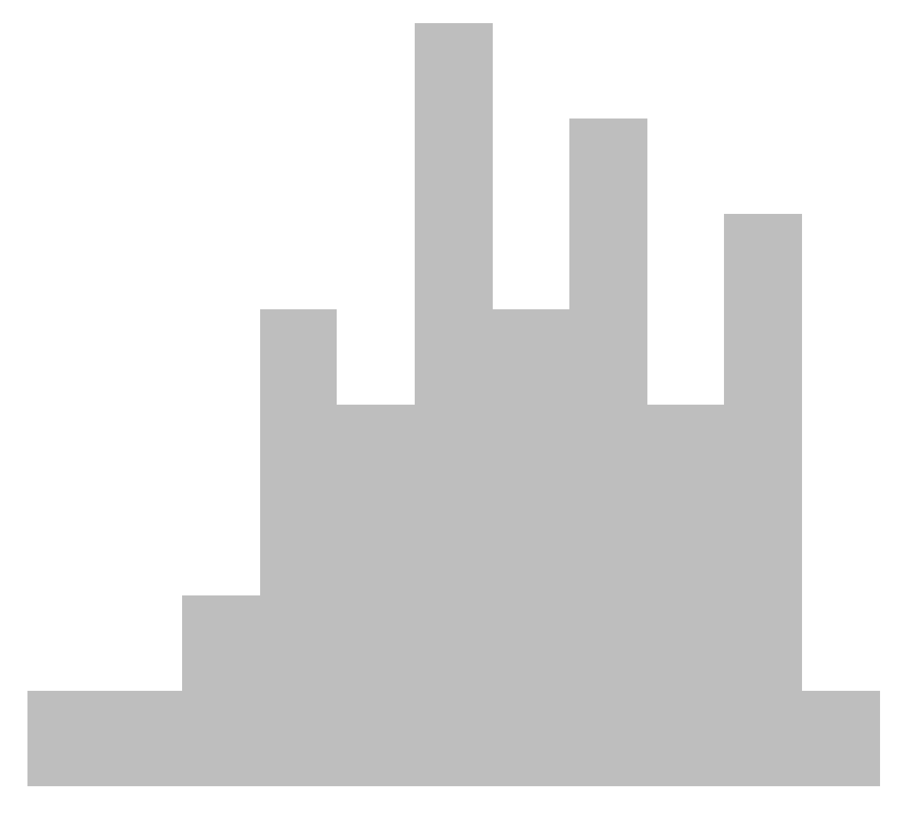
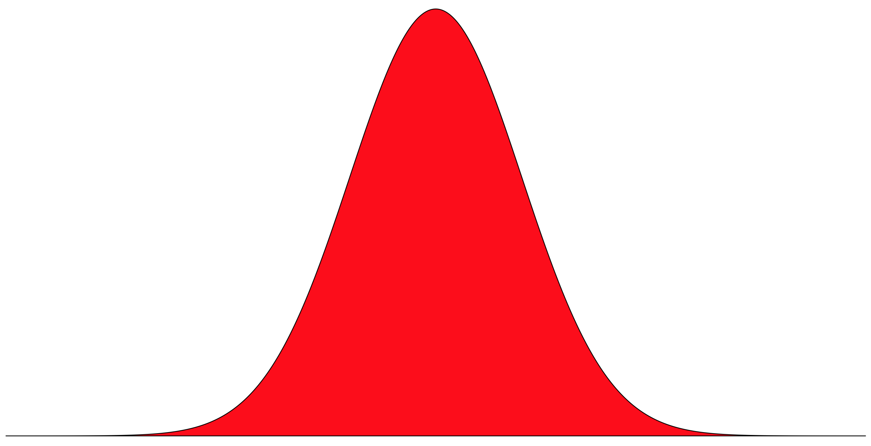
Univariate data
Population
Sample

Slide 4
Bivariate data

Slide 5
Bivariate data
Dependent / Response variable
The variable we wish to explain; by convention y

Slide 6
Bivariate data
Dependent / Response variable
The variable we wish to explain; by convention y
Independent / Explanatory variable
The variable we believe explains y; by convention x

Slide 7
Bivariate data
Atmospheric CO₂
Global temperature

Slide 8
Linear regression
y
x

Slide 9
Linear regression
y
x

Slide 10
Linear regression
y
x

Slide 11
Linear regression
Slope
y
x

Slide 12
Linear regression
y
x

Slide 13
Linear regression
y
Intercept
x

Slide 14
Linear regression
Slope
y
Intercept
x

Slide 15
Linear regression
Slope
y
y = ax + b
Intercept
x

Slide 16
Linear regression

Slide 17
Linear regression
Interpolation
y
x

Slide 18
Linear regression
Interpolation
Extrapolation
y
y
x
x

Slide 19
Linear regression
y
x

Slide 20
Linear regression
y
x

Slide 21
Linear regression
y
x

Slide 22
Linear regression
y
x

Slide 23
Linear regression
y
x
Notes:
Make connection to variance (i.e., sum of squares)

Slide 24
Linear regression
(Least squares)
y
x
Notes:
Make connection to variance (i.e., sum of squares)

Slide 25
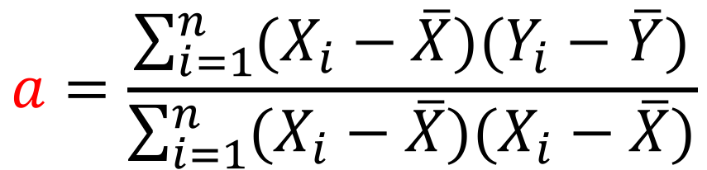
Linear regression
y
$$a=\frac{\sum_{i=1}^{n}{(X_{i}−\overline{X})(Y_{i}−\overline{Y})}}{\sum_{i=1}^{n}{(X_{i}−\overline{X})(X_{i}−\overline{X})}}$$
x

Slide 26
Linear regression
b = y - ax
y
$$a=\frac{\sum_{i=1}^{n}{(X_{i}−\overline{X})(Y_{i}−\overline{Y})}}{\sum_{i=1}^{n}{(X_{i}−\overline{X})(X_{i}−\overline{X})}}$$
x

Slide 27

Linear regression
slope <- lm(y ~ x)$coefficients[2]
intercept <- lm(y ~ x)$coefficients[1]

Slide 28
Linear regression
5
y
0
0
5
x
Notes:
Ask class what slope and intercept of this line are

Slide 29
Linear regression
5
y
y = -1x + 6
0
0
5
x

Slide 30
Interpreting slopes
y
x

Slide 31
Interpreting slopes
y
x
y
x

Slide 32
Interpreting slopes
y
y
x
x
y
x

Slide 33
Interpreting slopes
y
y
x
x
y
y
x
x

Slide 34
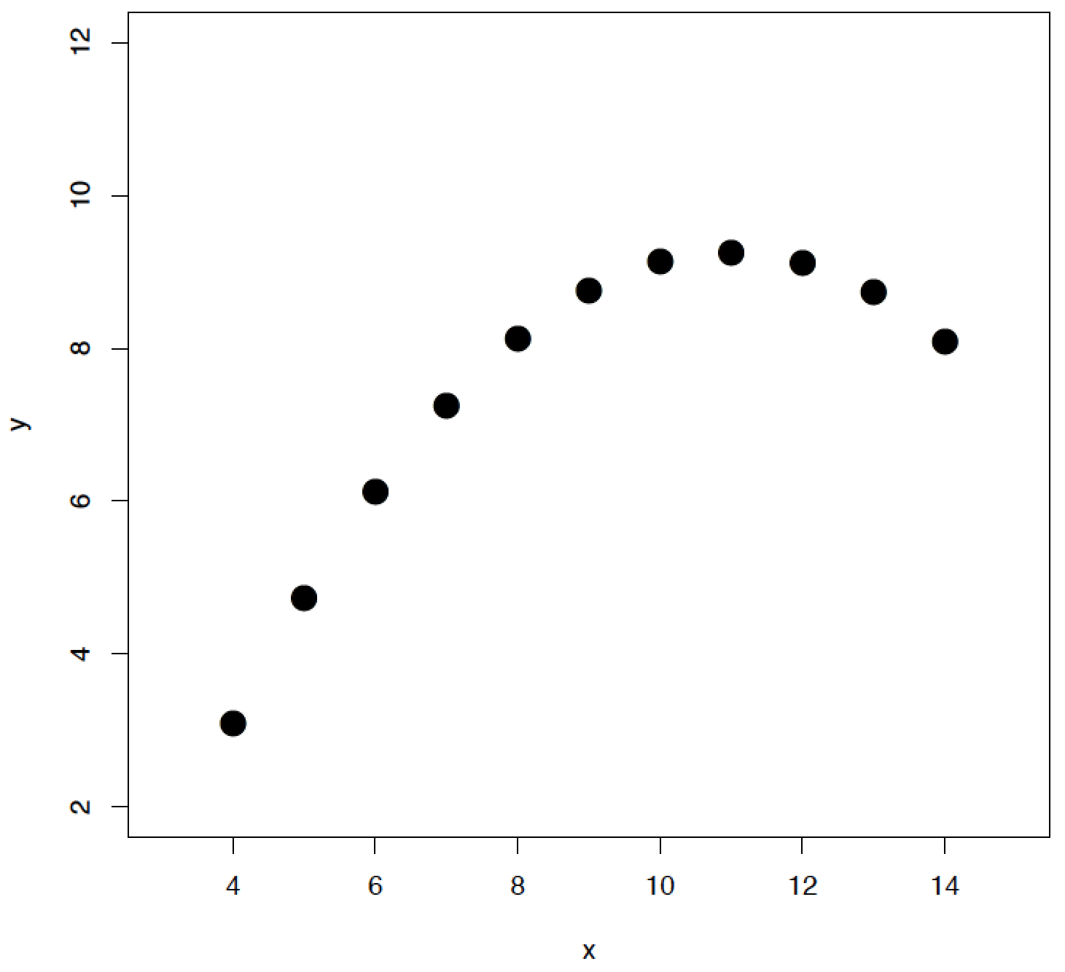
More complex regressions

Slide 35
More complex regressions
lm(y ~ poly(x, 2))
lm(y ~ poly(x, 3))
lm(y ~ poly(x, 4))

Slide 36
Exercise

Slide 37
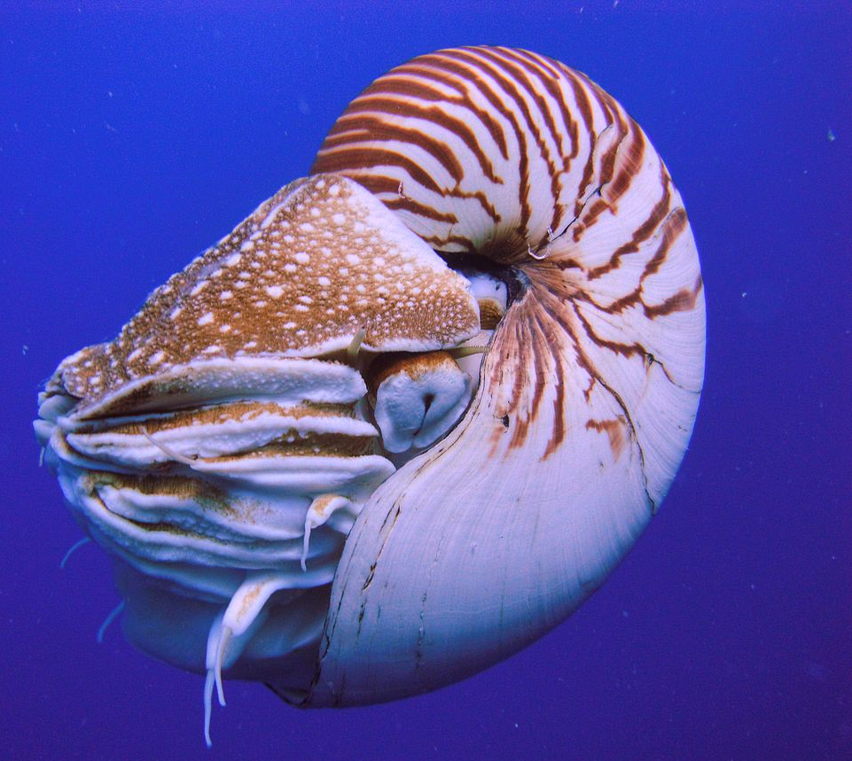
Exercise

Slide 38
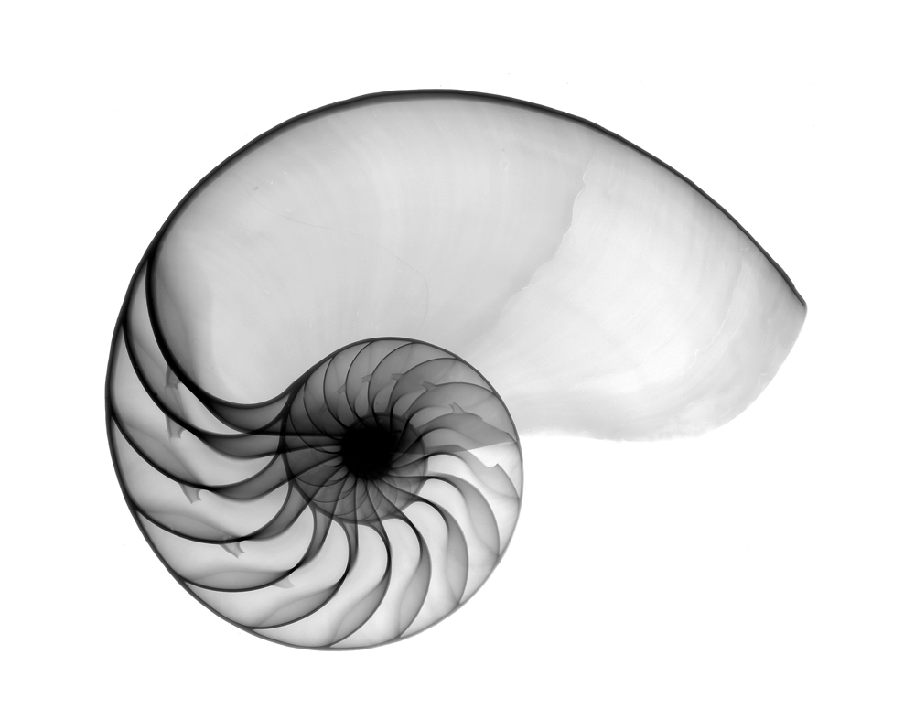
Exercise

Slide 39
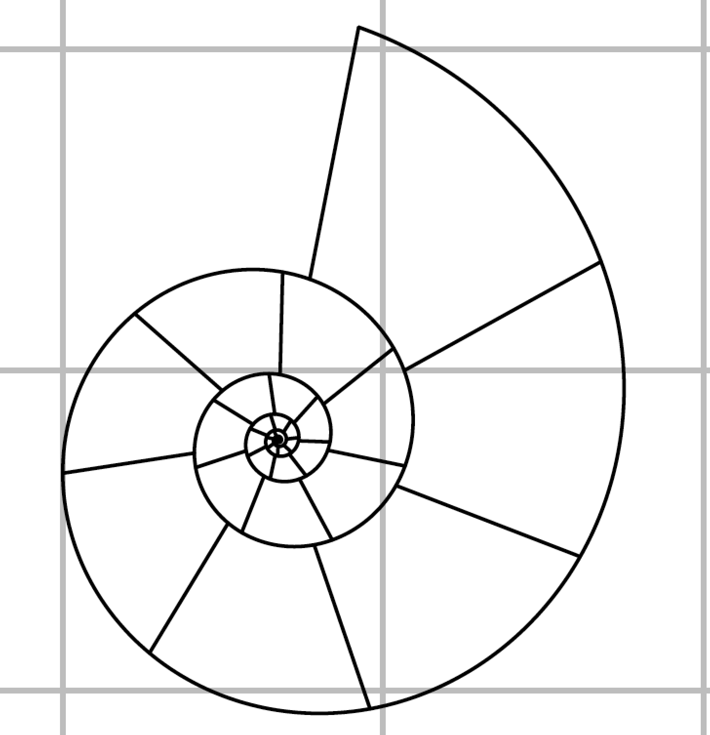
Exercise

Slide 40
Exercise
N Chambers
Diameter (mm)

Slide 41
Exercise
Notes:
How they will count chambers themselves in practical (i.e., problem of smallness at centre will be dealt with by using PDF and not printed version).

Slide 42
Exercise
x <- c(20, 22, 25, 28, 30)
y <- c(70, 90, 125, 190, 280)

Slide 43

Exercise
x <- c(20, 22, 25, 28, 30)
y <- c(70, 90, 125, 190, 280)
$$a=\frac{\sum_{i=1}^{n}{(X_{i}−\overline{X})(Y_{i}−\overline{Y})}}{\sum_{i=1}^{n}{(X_{i}−\overline{X})(X_{i}−\overline{X})}}$$

Slide 44
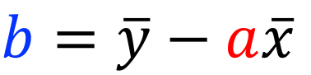
Exercise
x <- c(20, 22, 25, 28, 30)
y <- c(70, 90, 125, 190, 280)
$$a=\frac{\sum_{i=1}^{n}{(X_{i}−\overline{X})(Y_{i}−\overline{Y})}}{\sum_{i=1}^{n}{(X_{i}−\overline{X})(X_{i}−\overline{X})}}$$
$$b=\overline{y}−a\overline{x}$$

Slide 45
Exercise
x <- c(20, 22, 25, 28, 30)
y <- c(70, 90, 125, 190, 280)
$$a=\frac{\sum_{i=1}^{n}{(X_{i}−\overline{X})(Y_{i}−\overline{Y})}}{\sum_{i=1}^{n}{(X_{i}−\overline{X})(X_{i}−\overline{X})}}$$
$$b=\overline{y}−a\overline{x}$$

Slide 46
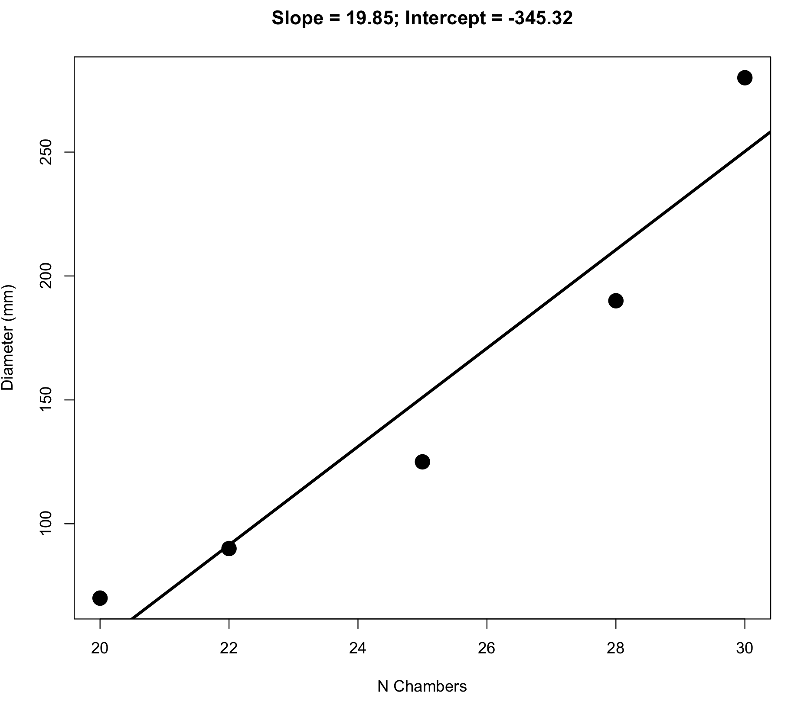
Exercise

Slide 47
Exercise

Slide 48
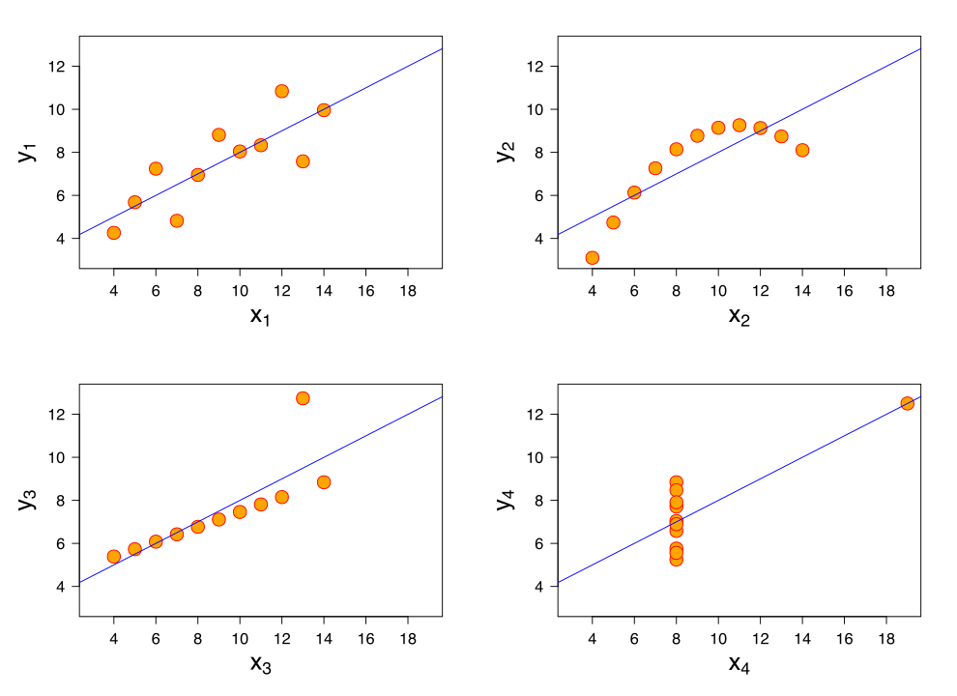
Anscombe’s quartet

Slide 49
Measuring relationships between variables

Slide 50
Measuring relationships between variables
Strength of relationship
How strong of an effect does x have on y?

Slide 51
Measuring relationships between variables
Strength of relationship
How strong of an effect does x have on y?
Sign of relationship
Does y increase (+ve) or decrease (-ve) as x increases?

Slide 52
Pearson correlation coefficient, r
-1
0
1

Slide 53
Pearson correlation coefficient, r
Step one
Normalise data (Z-statistic)

Slide 54
Pearson correlation coefficient, r
Step one
Normalise data (Z-statistic)
Step two
Place in expression for r that yields required values on -1 to 1 scale

Slide 55
Pearson correlation coefficient, r
Normalise
=
=
Notes:
Need to normalise as these are all 1 (i.e., slope value doesn’t matter)

Slide 56
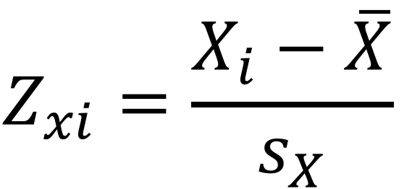
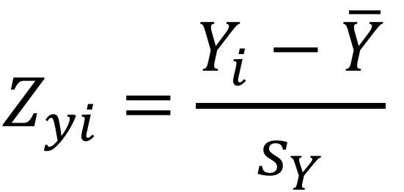
Pearson correlation coefficient, r
Normalise
$$Z_{xi}=\frac{X_{i}−\overline{X}}{s_{X}}$$
$$Z_{yi}=\frac{Y_{i}−\overline{Y}}{s_{Y}}$$
Notes:
Need to normalise as these are all 1 (i.e., slope value doesn’t matter)

Slide 57
Pearson correlation coefficient, r
Normalise
Standard normal
μ
μ = 0
σ = 1
$$Z_{xi}=\frac{X_{i}−\overline{X}}{s_{X}}$$
$$Z_{yi}=\frac{Y_{i}−\overline{Y}}{s_{Y}}$$
-1σ
1σ
Notes:
Need to normalise as these are all 1 (i.e., slope value doesn’t matter)

Slide 58
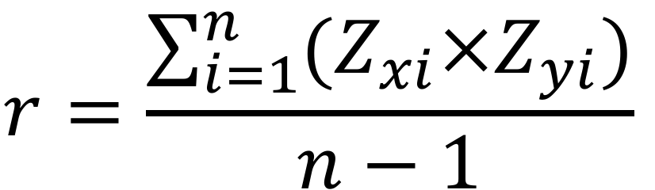
Pearson correlation coefficient, r
Expression for r
$$r=\frac{\sum_{i=1}^{n}{(Z_{xi}×Z_{yi})}}{n−1}$$

Slide 59
Pearson correlation coefficient, r
cor.test(x = x, y = y)$estimate

Slide 60
Pearson correlation coefficient, r
cor.test(x = x, y = y)$estimate
0.9593645

Slide 61
Pearson correlation coefficient, r
cor.test(x = x, y = y)$estimate
0.9593645
cor.test(x = x, y = y)$p.value

Slide 62
Pearson correlation coefficient, r
cor.test(x = x, y = y)$estimate
0.9832309
cor.test(x = x, y = y)$p.value
0.009772999

Slide 63
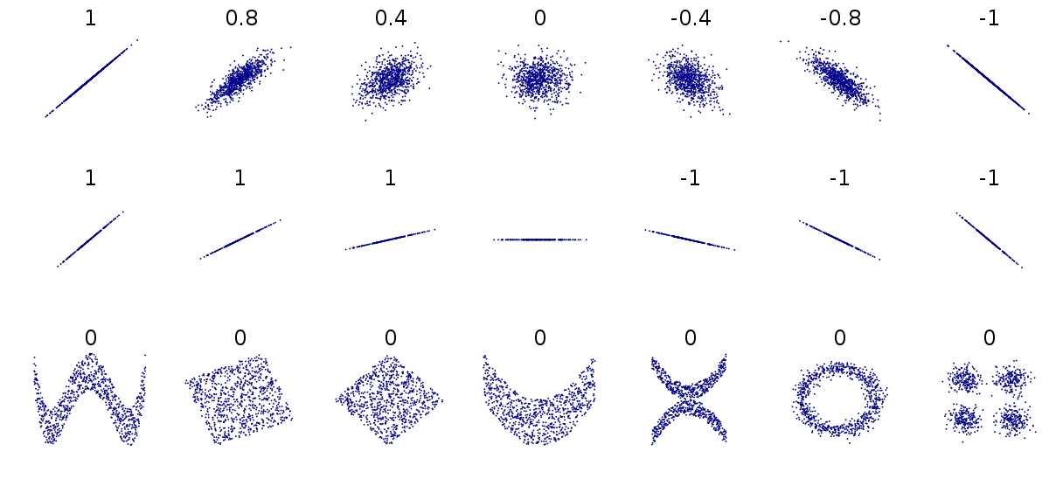
Pearson correlation coefficient, r

Slide 64
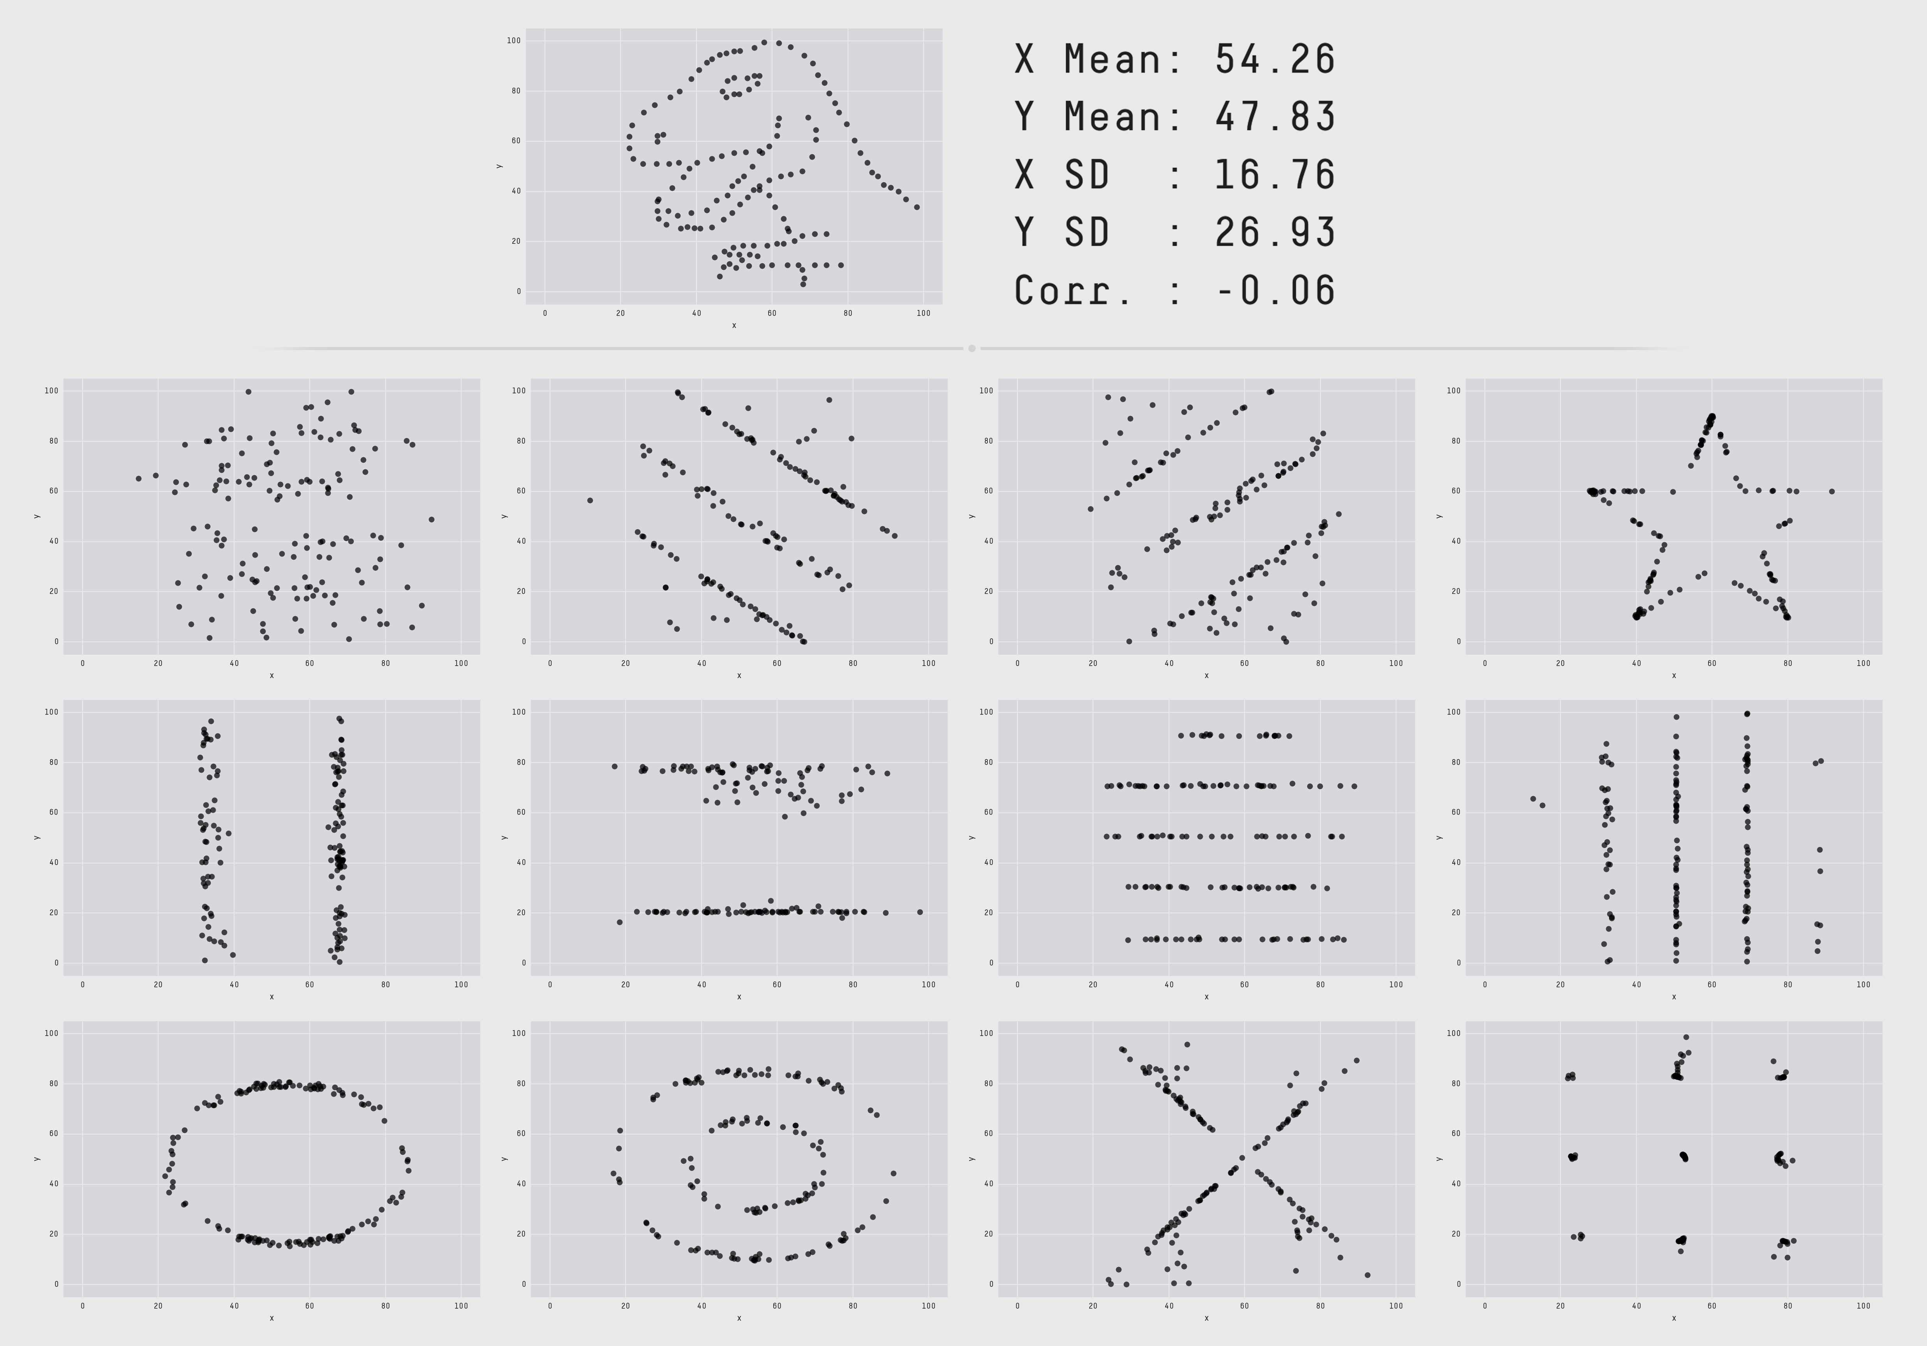
Pearson correlation coefficient, r
Source: autodeskresearch.com/
publications/samestats

Slide 65
Correlation and causation

Slide 66
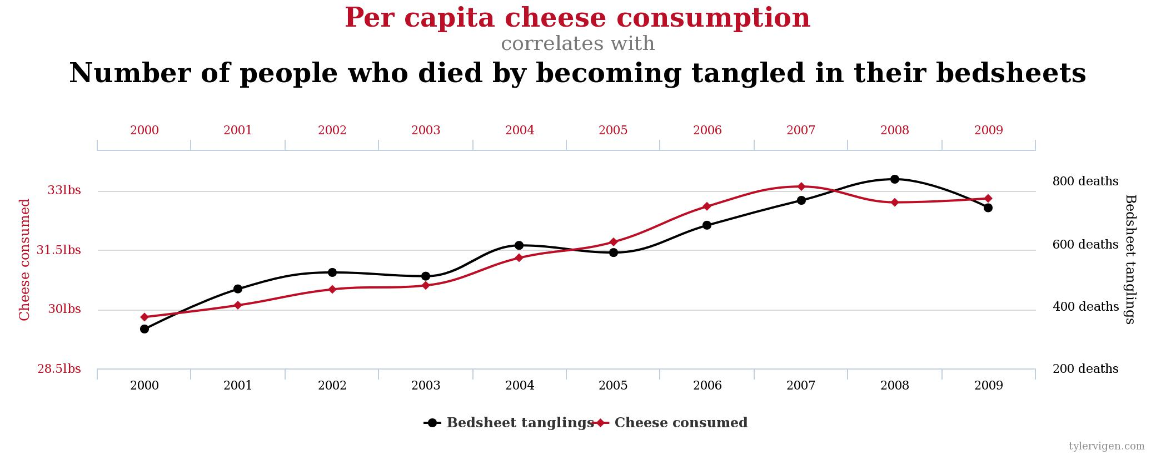
Correlation and causation
Source: tylervigen.com/spurious-correlations

Slide 67
Autocorrelation

Slide 68
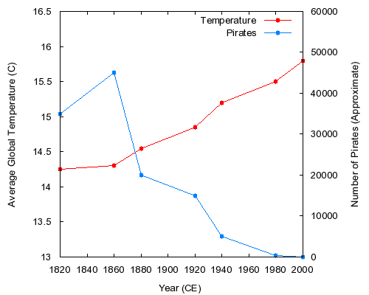

Autocorrelation

Slide 69
Autocorrelation
cor.test(x = pirates,
y = temp)$estimate
-0.9242241
cor.test(x = pirates,
y = temp)$p.value
0.00291353

